Slide 1

Wellness & Health at Macalester
Kelly Fang
WHAM Co-Chair, Wellness Coach and
Senior Well-being Program Manager

Slide 2

WELLNESS REWARD REMINDER
Deadline October 31, 2023

Slide 3
2023 Wellness Incentive Reminder
Available to Health Plan Participants
Employee Only
Activity
Health assessment
Activity
1
Mastercard
$150
2
1234 5678 9101 2345
YOUR NAME HERE
3

Slide 4
2023 Wellness Incentive Reminder
Available to Health Plan Participants
Activity
Health assessment
Activity
1
Employee
1
2
Mastercard
$300
3
2
1234 5678 9101 2345
Activity
Health assessment
Activity
1
Spouse
Or Partner
YOUR NAME HERE
3
2
3

Slide 5
Change for 2024
Employee and Spouse/Partner can each earn their own reward
Activity
Health assessment
Activity
Mastercard
$150
1
Employee
1
2
1234 5678 9101 2345
3
YOUR NAME HERE
2
Activity
Health assessment
Activity
Mastercard
$150
1
Spouse
Or Partner
3
2
1234 5678 9101 2345
3
YOUR NAME HERE

Slide 6

2023 HEALTH
ASSESSMENT
RESULTS
Data from
January – July 2023
N = 242 repeat participants

Slide 7
Data shows the percentage
of our cohort population at risk – lower is better

Slide 8


Slide 11
Key Take-Aways
Depression, Diabetes, High Blood Pressure & High Cholesterol, Back Pain, Physical Health risk increase
Alcohol consumption decrease
Increase by around 10% in participants getting between 7&9 hours, fewer reporting fair or poor quality of sleep
More people taking time to think about the good in life
More people score life satisfaction as 8+/10
Fewer people donating to charity and more people enrolled in a savings plan
Alcohol, Nutrition, Weight, Back Pain– top readiness to change (already making changes)
Top 3 topics of interest: Physical Activity, Nutrition, Weight, Stress

Slide 12

2024 FOCUS AREAS

Slide 13

Aligning the Framework with Key Priorities Identified From the Health Assessment Results
Protection from Harm
Mental & Emotional Health
Connection and Community
Job Satisfaction & Belonging
Work-Life Harmony
Nutrition, Blood Pressure & Back Pain

Slide 14
WHAM’s Resources and Tools to Support our Staff and Faculty
Mental & Emotional Health
EAP & Nice
Job Satisfaction & Belonging
Lunch & Learns
Nutrition, Blood Pressure, & Back Pain
Classes
Classes
Challenges
myStrength
Lunch & Learns
January Thaw
Spring Bloom
Market & Music Series
Health Coaching
Mindfulness & Yoga
Lunch & Learns

Slide 15
Review
Program components
Health assessment
Wellness coaching
Macalester specific activities
Disease & Case Management
Tracking activities
  10,000 Steps
  Sleep tracker
  Stress tracker
Digital activities
  Choose to Lose
  Go for Fruits & Veggies
  Healthy Thinking
  Sugar Smart
  Tackle Stress
  Wellbeats
  Vape: Think Twice
  myStrength

Slide 16
Review
Macalester Specific Activities
  Preventive Visit
  6-Week WHAM Activity Class
  3 WHAM Lunch and Learns
  Nice Healthcare Services
  Macalester’s Wellness 5K
  Leonard Center or Gym of Your Choice
  Personal Training with Taylor Ulrich
  EAP Wellness Seminars

Slide 17

NEW
ACTIVITY

Slide 18


Slide 19
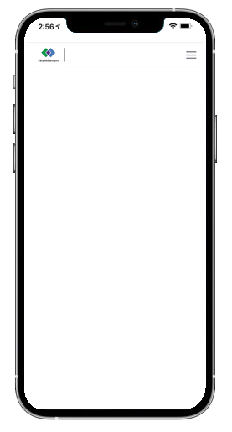

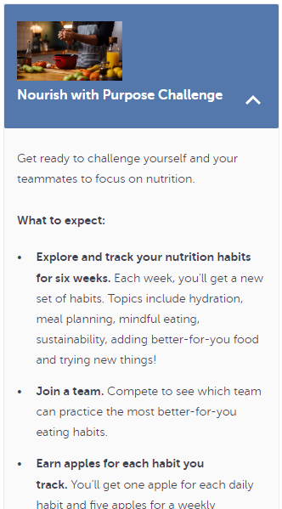

Well-being Team Challenge: Nourish with Purpose
Habits
Hydration
Meal planning
Mindful eating
Sustainability
Adding better-for-you foods
Trying new things
You’ll get one apple for each daily habit
Your team can earn 5 apples for a weekly community habit
The team with the highest total average apples wins!

Slide 20

For details visit:
macalester.edu/wham
On January 2, 2024, log on to:
healthpartners.com/livingwell

